Slide 1
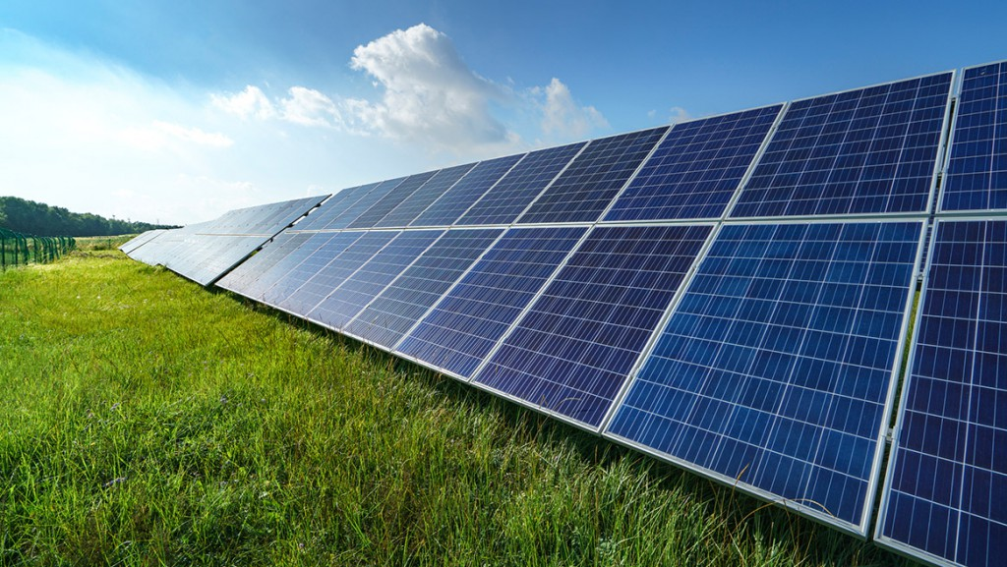
RENEWABLE ENERGY AND WEATHER CONDITIONS
Presentation by: Joan Gathu

Slide 2
PROBLEM STATEMENT
Analyze the relationship between weather conditions and renewable energy generation, particularly solar energy.
Develop models that can predict future energy output based on weather patterns.

Slide 3
Data
Energy delta – Change in energy consumption over the given time period,(Wh).
GHI (Global Horizontal Irradiance) – The amount of solar radiation received by a horizontal surface (W/m²).
Temperature – degrees Celsius (°C)
Atmospheric Pressure –hPa (hectopascals)
Relative Humidity –Percentage (0-100)
Wind Speed – meters per second (m/s)
Rain_1h – Amount of rain (mm) that has fallen in the last 1 hour.
Snow_1h – Amount of snow (mm) that has fallen in the last 1 hour.
Clouds_all – Cloud coverage percentage (0-100)
Hour – The hour of the day for the given data point (0 - 23).
Month – The month number for the given data point. (1 - 12)
Time – Timestamp of the data point (in hourly intervals).
Year - The year number for the given data point. (2017-2022)
SunlightTime – Duration of sunlight (in hours) during the given time period.
DayLength – Length of the day (from sunrise to sunset) in hours.
IsSun – Binary indicator (1 or 0) indicating whether the sun is currently visible (1) or not (0).
SunlightTime/DayLength – Ratio of the available sunlight time to the total day length.
Weather_type – Categorical description of the overall weather condition (e.g., clear, cloudy, rainy, etc.).
Notes:
Yellow: Corrected from minutes to hours
Blue: Corrected for dtype and also not used within the ML models
Green: Derived
Red: Eliminated

Slide 4
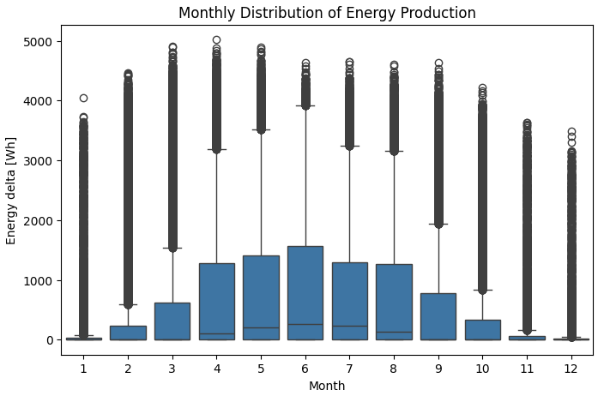
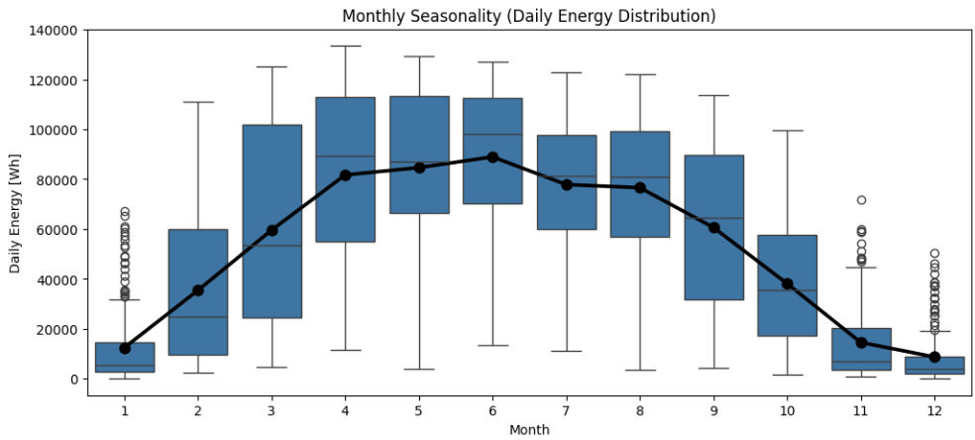
Exploratory Data Analysis
Peak Production: May through August consistently produce more energy, likely due to increased sunlight or favorable weather.
Lowest Production: Winter months have subdued production, indicating seasonal dependence, probably for a solar energy context.
Data Quality: High variability and many outliers suggest occasional extreme days, which may warrant further investigation for operational or environmental factors.
All months present a wide spread (long whiskers and many outliers), especially in peak months, indicating significant variability in daily energy output. Outlier points above the whiskers suggest occasional days of unusually high production

Slide 5
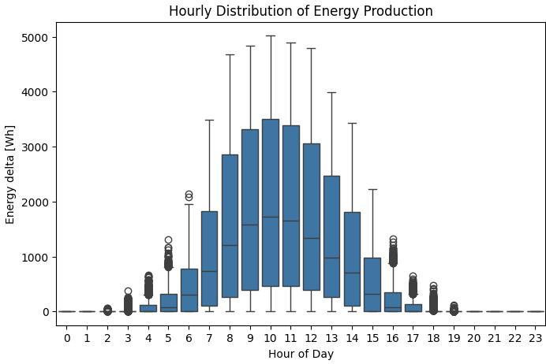
Peak Production: Energy production begins increasing around hour 5 (5 AM), rising steeply between 7 AM and 13 PM, and peaking from around hour 10 to 12 (10 AM–12 PM).
Production Window: There is negligible energy generated during nighttime hours (0–4 AM and 19–23 PM), indicating the system produces energy almost exclusively during daylight.
Hourly Variation: Highest median output occurs during hours 10–12. Boxes and whiskers are wider during peak hours (7–14), indicating greater variability and higher maximum values. Early morning and late afternoon hours have smaller output and less spread.
Notes:
Insights
Daylight Dependence: The energy system is highly dependent on daylight, consistent with solar energy generation patterns.
Operational Planning: Understanding these hourly patterns helps schedule maintenance, predict supply, and optimize load management to match peak generation times.
Maximum Utilization: The middle hours of the day are most productive, suggesting that consumer loads or storage systems should be aligned with these intervals for best efficiency.

Slide 6
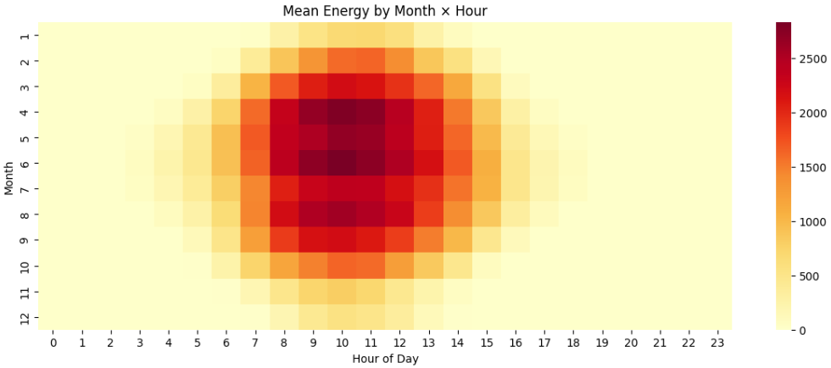
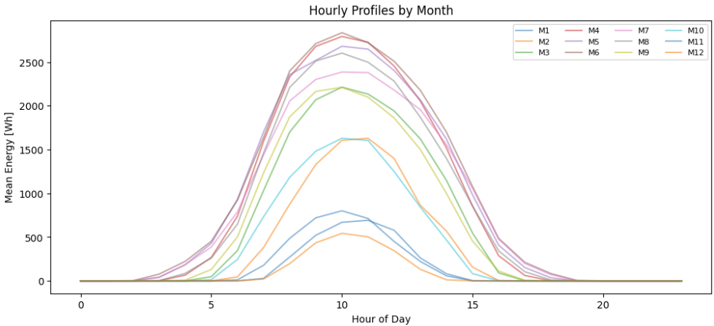
Seasonality and Trend Analysis: Identifying and modelling seasonal effects and long-term trends in renewable energy generation across different months and hours of the day.
The highest mean energy production occurs between hours 8–14 and months 5–8 (May–August), indicating concentrated generation during mid-day in summer months.
Months 5–8 have the broadest and darkest bands, signifying peak seasonal production.
Months outside this window, especially winter months (1, 2, 11, 12), show much lower and shorter bands of production.
Energy output sharply intensifies after sunrise (around hour 6) and drops off beyond hour 15.
Nighttime hours (0–4, 19–23) consistently have negligible production across all months.
Notes:
Insights
Productivity Window: The system is most productive during summer months and midday hours, aligning with strong and extended sunlight availability.
Seasonal Strategy: Operational planning should focus on maximizing production and storage during the visible peak intervals for optimal efficiency.
Load Matching: Demand-side management can be tailored to match these high-output periods, maximizing the system’s renewable benefits.

Slide 7
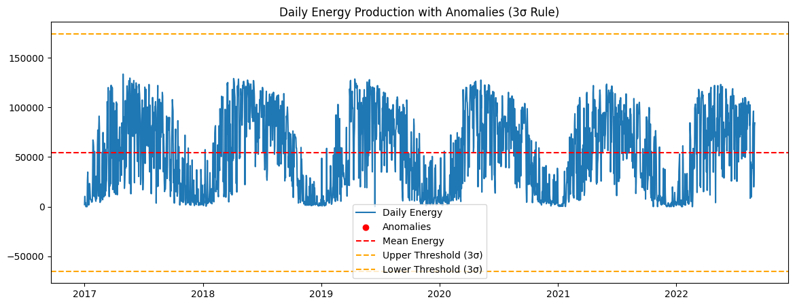
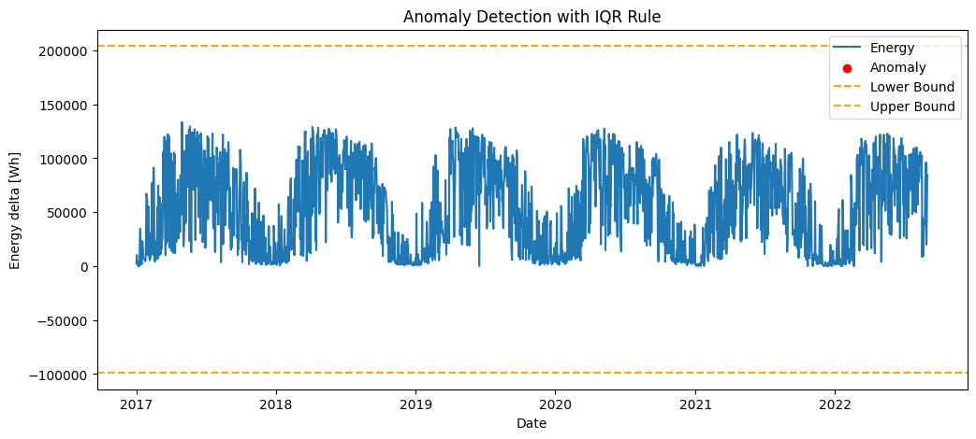
Anomaly Detection:
Using 3σ rule
The 3-σ Rule flags anomalies as values more than three standard deviations from the mean, since such values are extremely unlikely in normally distributed data
Using IQR Rule:
The IQR Rule detects anomalies by finding points that lie far outside the typical range of the middle 50% of the data.
Flags points outside:
Q1–1.5×IQR (too low)
and
Q3+1.5×IQR (too high)
Notes:
The idea comes from statistics of the normal distribution:
In a Gaussian distribution:
~68% of data lies within 1 standard deviation (μ ± 1σ)
~95% within 2σ
~99.7% within 3σ
So, values beyond μ ± 3σ are very rare (probability ~0.3%). This makes them strong candidates for anomalies/outliers.

Slide 8
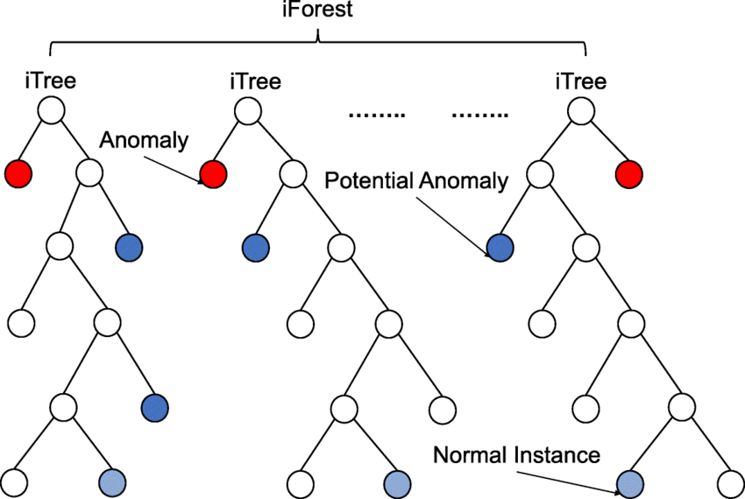
Anomaly Detection:
Detect anomalies in energy production and consumption related to unusual weather events, such as heavy rainfall or cloud cover, using unsupervised learning techniques.
Isolation Forest:
Isolation Forest is an unsupervised anomaly detection algorithm that operates on the principle of isolating anomalies rather than profiling normal data points.
It is an ensemble method, meaning it builds a "forest" of multiple decision trees.
Pros:
Scales well to large datasets.
Works for high-dimensional data.
Handles nonlinear boundaries.
Cons:
Requires tuning contamination rate (contamination).
May struggle with very clustered anomalies.
Pros: Fast, scalable, works well with many features.
Best for: Large tabular datasets (e.g., solar + weather).
Notes:
The idea comes from statistics of the normal distribution:
In a Gaussian distribution:
~68% of data lies within 1 standard deviation (μ ± 1σ)
~95% within 2σ
~99.7% within 3σ
So, values beyond μ ± 3σ are very rare (probability ~0.3%). This makes them strong candidates for anomalies/outliers.

Slide 9
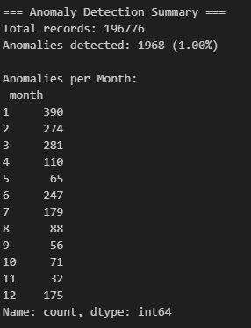
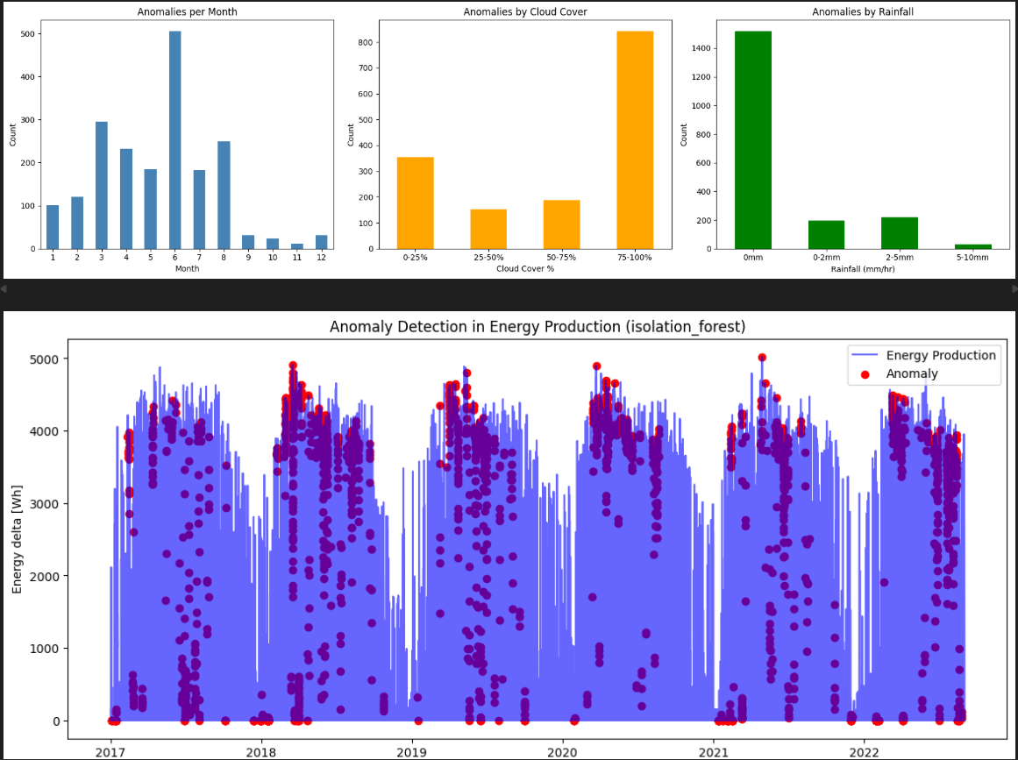
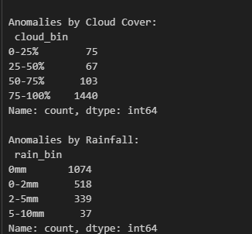
Unsupervised Anomaly Detection Models: IsolationForest, OneClassSVM, DBSCAN
Notes:
Machine learning methods: Isolation Forest, One-Class SVM, Autoencoders are better for complex, high-dimensional anomalies.

Slide 10
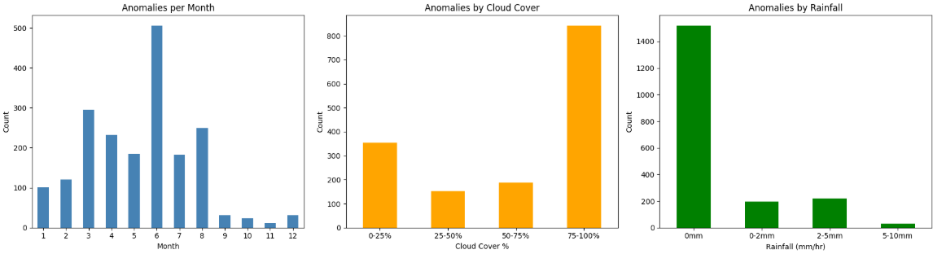

Slide 11
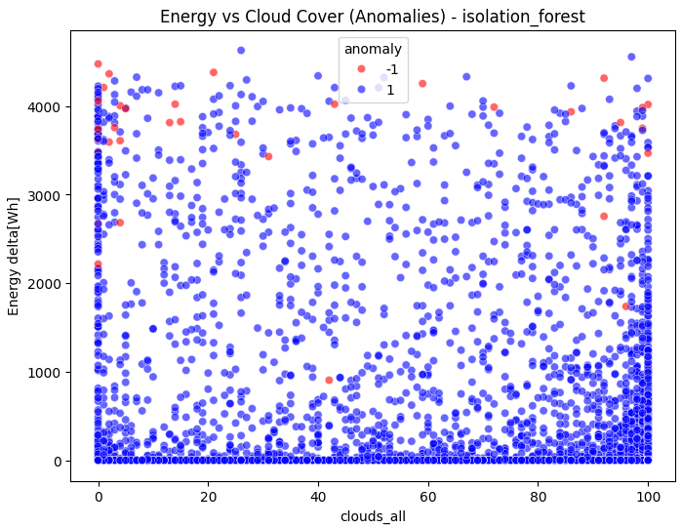
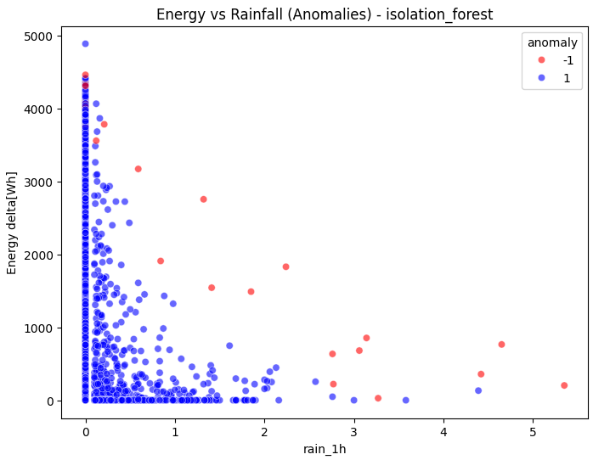

Slide 12
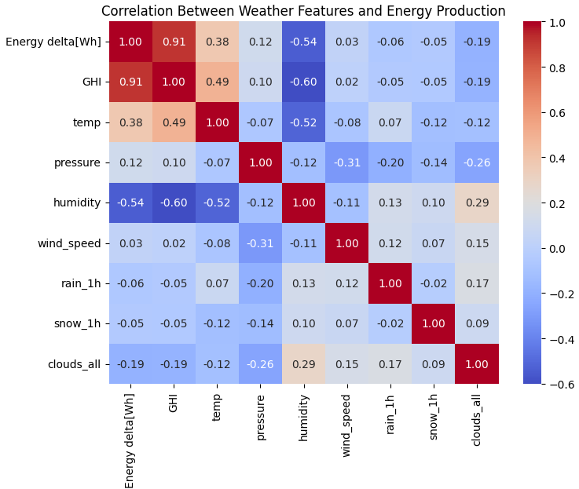
Correlation Analysis
Task: Analyze the correlation between weather conditions (e.g., temperature, humidity, cloud coverage) and renewable energy production (e.g., energy delta, GHI) to identify key factors influencing energy generation.
GHI is the single strongest predictor of energy output.
Humidity also matters a lot (strong negative correlation).
Temperature has a moderate positive effect, but partly because clear, sunny days are also warmer.
Clouds_all and precipitation (rain/snow) reduce solar output, but their correlations are weaker.
Pressure and wind speed contribute very little directly.
Notes:
- correlation between weather conditions (e.g. temperature, humidity, cloud coverage) and renewable energy production (e.g., energy delta, GHI) to identify key factors influencing energy generation

Slide 13
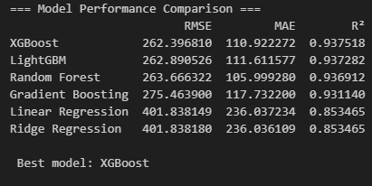
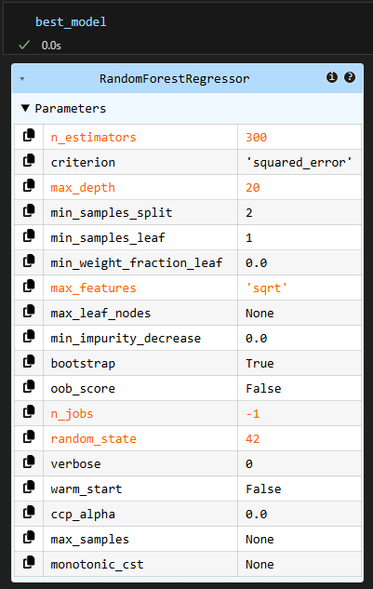
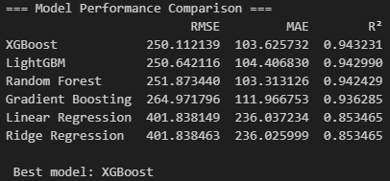
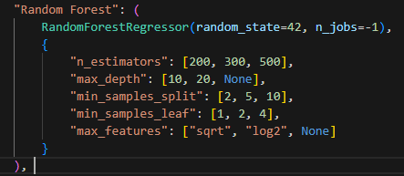
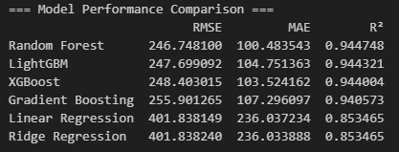
Model Performance
Manual Hyper parameter tuning
Auto Hyperparameter Tuning
Notes:
Where it automatically tunes models using RandomizedSearchCV with cross-validation.
It tests multiple combinations and picks the best for each model.

Slide 14
Auto Hyperparameter Tuning: Steps Followed
Define search space
Example:
"n_estimators" : number of trees
"max_depth": tree depth
"min_samples_split":
"min_samples_leaf":
"max_features":
“learning_rate” : step size for boosting
Each model (RF, GBM, XGB, LGBM, Ridge) had its own parameter ranges.
Run RandomizedSearchCV
For each model, test ~20 random combinations.
Evaluate each using 3-fold cross-validation.
Select best parameters
Choose the parameter set with the lowest average RMSE.
Evaluate on test set
Train the best version of each model on training data.
Compare them on the test set (RMSE, MAE, R²).

Slide 15
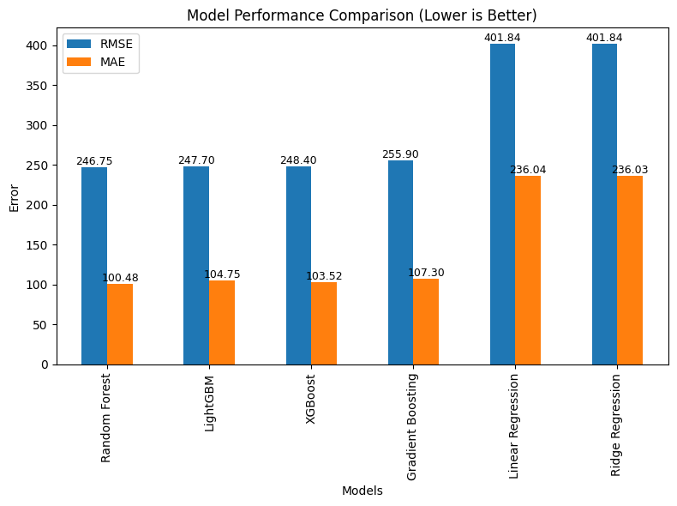
Model Performance
Ensemble tree models (Random Forest, LightGBM, XGBoost,) capture the nonlinear weather–energy relationships best, achieving ~94% accuracy (R²).
Random Forest is the top performer, with lowest RMSE, lowest MAE and highest R².
Gradient Boosting lags a bit, but still strong.
Linear models (Linear & Ridge Regression) underfit with ~85% accuracy. They are much weaker as they have high error & low R².

Slide 16
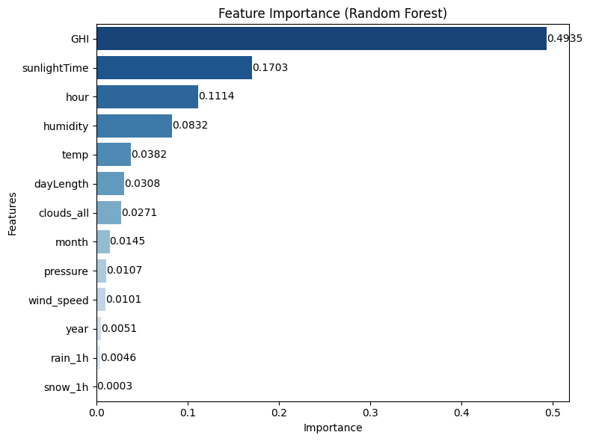
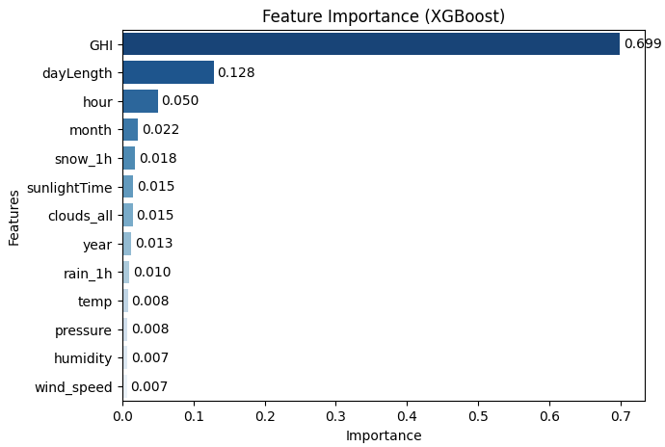
Feature Importance
GHI, SunlightTime & Hour explains ~77% of predictive power.
RF distributes importance more evenly, highlighting sunlight duration and humidity as key weather refinements.
GHI, DayLength & Hour explain ~88% of predictive power
Energy production is explained mostly by solar radiation (GHI) + solar geometry (DayLength, Hour).
Consistency across both models boosts confidence in GHI + Time + Weather as critical predictors
Notes:
Consistency across models boosts confidence in GHI + Time + Weather as critical predictors

Slide 17
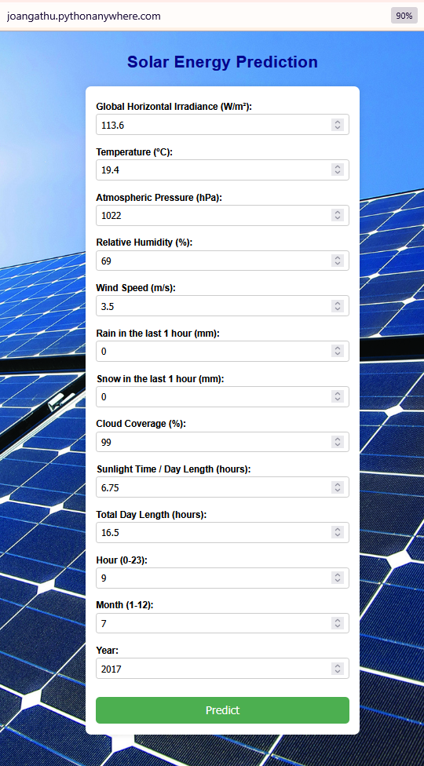
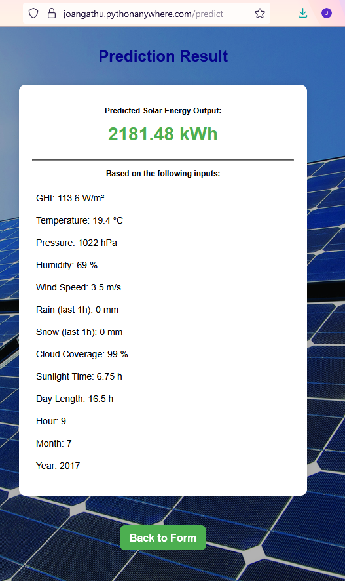
Prediction Display
https://joangathu.pythonanywhere.com/

Slide 18

THANK YOU
QUESTIONS?

